Slide 1
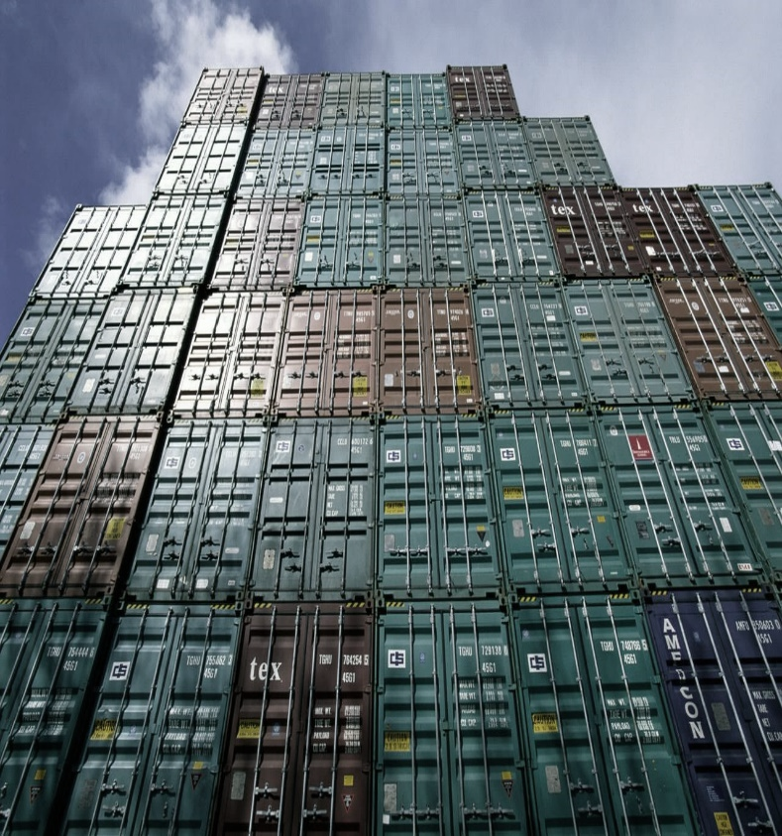
Fiji and the Generalized System of Preferences (GSP) Program
October 2018

Slide 2
Presentation Summary
Overview of USTR and the U.S. GSP Program
GSP Exports and Benefits Review for Fiji and Pacific Island neighbors
How to increase use of duty-free opportunities

Slide 3
Role of USTR (United States Trade Representative)
Cabinet-level agency which coordinates U.S. trade policy
Acts as lead negotiator, administrator of preference programs, and represents U.S. at WTO
Led by Ambassador Robert Lighthizer
Office of Trade Policy and Economics administers GSP)

Slide 4
Pacific Islands Trade Summary
U.S. exports essential goods such as food products, aircraft, construction equipment, and other goods
The United States is a Pacific nation
State of Hawaii, and U.S. territories of Guam, American Samoa, and Northern Marianas
Home to 1.2 million people of Pacific Island descent
Compact relationship with Micronesia, Palau, and Marshall Islands
Mutual defense treaty relationship with Australia and partnership with New Zealand

Slide 5
The United States is a major importer from the Pacific Islands
$520 million per year in Pacific Island imports; #1 market for Fiji
2,760 tons of preserved ginger per year
(Fiji #3)
58,000 tons of fresh taro per year
(Fiji #7, Samoa #9, and Tonga #17)
$15.4 million worth of coral per year
(Solomon Islands #10, Fiji #11, Tonga #14, Micronesia, Marshall Islands, Palau, and French Polynesia)
$9.2 million worth of vanilla per year
(Papua New Guinea #5, French Polynesia #8, Tonga #11)

Slide 6
GSP Program Overview
Enhanced access to U.S. market
Provides duty-free treatment for almost 3,500 products from Fiji
Expanded choices for U.S. industries and consumers
$21.2 billion in total U.S. GSP imports in 2017
GSP program currently authorized
through December 2020

Slide 7
U.S. tariff schedule
Total of 11,083 products
4,084 MFN-zero products
Includes water, wood, most energy and metal ores, vanilla, coffee, most fresh fish, coral, turmeric, information technology, medicines and medical equipment, and aircraft
3,743 products are subject to permanent tariffs (and excluded from GSP)
Includes most clothing, shoes, and automobiles
3,256 products are eligible for GSP benefits
Includes under-quota sugar, fresh and chilled taro, ginger, value-added wood products, jewelry, craft goods, most boat parts & boats
1,490 additional products are eligible for duty-free treatment for Kiribati, Solomon Islands, Samoa, Tuvalu, and Vanuatu

Slide 8
Country eligibility
Income under $12,055 per capita
Expropriation/Arbitral Awards
Taking steps to protect internationally recognized worker rights, including stopping child labor
Market Access for U.S. exports
U.S. Intellectual Property Rights protected
Full description and list in Guidebook
https://ustr.gov/sites/default/files/The%20GSP%20Guidebook.pdf

Slide 9
Which other countries are in GSP?
120 countries & territories including neighbors: Indonesia, Fiji, Kiribati, Papua New Guinea, Philippines, Samoa, Solomon Islands, Tonga, Tuvalu, Vanuatu

Slide 10
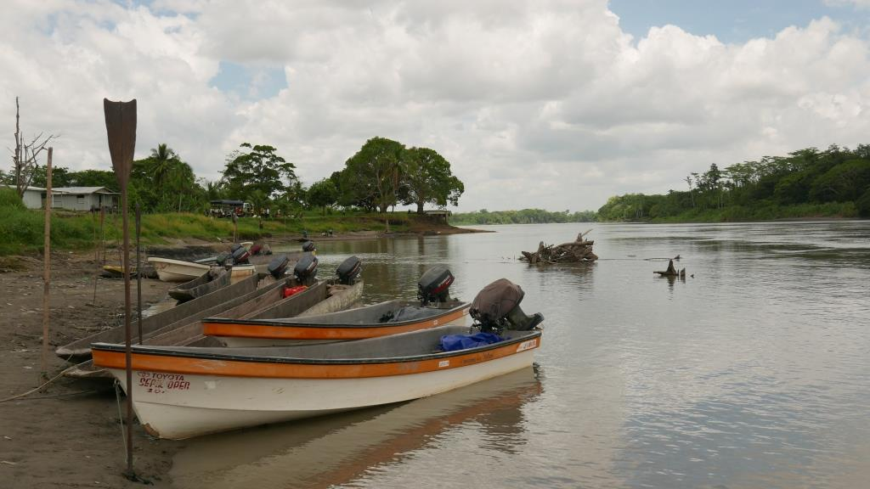
Least-Developed Beneficiary Countries (LDBCs)
Based on the United Nations’ list of least-developed countries
Includes Kiribati, Solomon Islands, Samoa, Tuvalu, and Vanuatu
LDBCs are eligible for additional 1,490 products under GSP
Including tuna and skipjack, vegetables, vegetable fats, wastes of distillate and residual fuels, and ceramics

Slide 11
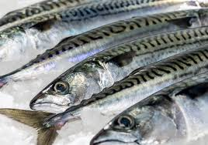
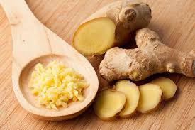
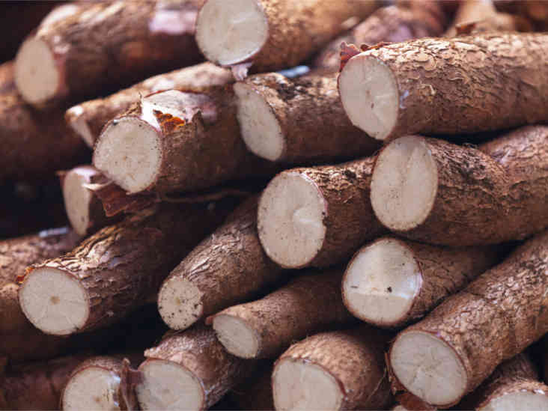
Product eligibility
Eligible
Ineligible
Many manufactured items and inputs
Travel goods (e.g. backpacks, purses)
Jewelry
Some agricultural products
Many chemicals
Many minerals
Most textiles and apparel
Watches
Footwear
Some gloves and leather goods
Many agricultural products

Slide 12
How to Qualify for Duty-Free Treatment under GSP
GSP-eligible product
Product or growth of the GSP Country
Local content must be ≥ 35% of the value
Can’t enter commerce of another country
Benefit claimed by importer
Keep records to verify GSP claim
12

Slide 13
Fiji GSP exports to the United States, 2017
Exports under GSP accounted for 8% of total exports to U.S.
Total exports were $222 million in 2017, $19 million of which were under GSP
Exports under GSP increased by 72% from 2016-17
Top GSP products, 2017:
Cane sugar ($12.6 million)
Ginger root ($3.2 million)
Fresh or chilled taro ($1.4 million)
GSP benefits were fully utilized for more than half of GSP-eligible products in 2017

Slide 14
Examples of duty savings on Fijian exports, 2017
HTS8 description | MFN rate, or non-GSP rate | Imports for consumption (U.S. dollars) | Share of eligible imports using GSP (percent) | Duty savings (U.S. dollars)
Other cane sugar, raw, in solid form, w/o added flavoring or coloring, subject to add. US 5 to Ch.17 | 2.6% | $13,000,000 | 100% | $333,000
Ginger root, preserved by sugar (drained, glace or crystallized) | 2.4% | $3,000,000 | 96.8% | $74,000
Fresh or chilled taro (Colocasia spp.), whether or not sliced or in the form of pellets | 2.3% | $1,000,000 | 100% | $31,000
Bakers' wares communion wafers, empty capsules suitable for pharmaceutical use, sealing wafers, rice paper and similar products, nesi | 4.5% | $615,000 | 99.6% | $28,000

Slide 15
Example: GSP advantage for Fiji’s ginger root exports
HTS 2006.00.30
MFN (non-GSP) duty rate of 2.4%
Importers pay 2.4% duty when importing from many competitors, including China, Australia, and Korea
Importers pay 0% on GSP imports from Fiji
Buyers would save $2.40 per $100 in ginger bought from Fiji

Slide 16
U.S. imports from other Pacific Island countries, 2017
Solomon Islands
$2.4 million in imports
Two products were imported under GSP
Tuna ($2.3 million, 94% under LBDC GSP benefits)
Wood marquetry and inlaid wood (100% under GSP benefits)
Other products such as certain tubes and pipes, certain berries, electrical boards, plastic lids, and many others are eligible for GSP benefits
Marshall Islands
$8.7 million of imports including imports under Marshall Islands Compact
Most of which were tuna and other fish

Slide 17
U.S. imports from other Pacific Island countries, 2017
Samoa
$4.9 million of imports, $1.4 million of which received GSP benefits, including fruit juice and fresh taro
Tonga
$3.5 million of imports, $300,000 of which received GSP benefits, including cassava, yams, and basketwork
Vanuatu
$5.4 million of imports, including plants used in perfumery and pharmaceutical purposes, squid, and swordfish

Slide 18
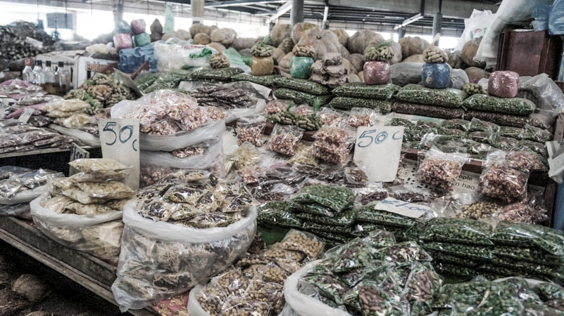
How to Increase Duty-Free Exports to the U.S.
Consider products with a GSP advantage
Identify GSP-eligible products exported to other markets
Ensure that GSP is claimed
Use GSP as a marketing tool
Notes:
Fix bullets

Slide 19
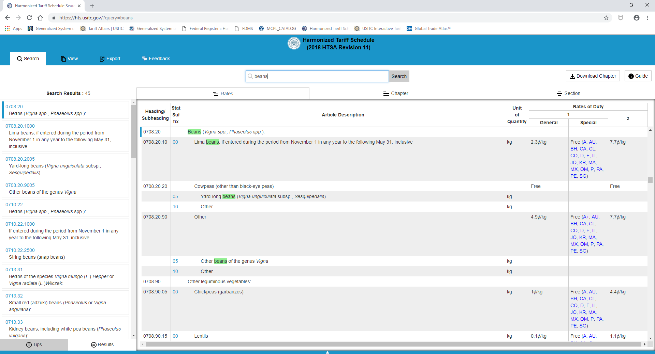
How to determine if a product is GSP eligible
Visit https://hts.usitc.gov
“A” = eligible for all BDCs
“A+” = eligible for LBDCs only

Slide 20
GSP decision-making process to add or remove countries and products
Country-specific
Product-specific
Petitions submitted by interested parties
or
U.S. government self-initiates a review following the triennial country assessment process
Petitions submitted by interested parties
2017 examples:
Addition of rolled or flaked grains
Removal of glycine

Slide 21
Identifying & Developing Potential U.S. Buyers
Depends on size, sector, experience
Understanding the US market
What kind of relationship: agent, distributor, partner, joint venture
Best leads: your own network!
Trade shows

Slide 22
Questions on GSP?
USTR Contacts
Email: gsp@ustr.eop.gov
Phone: +1 (202) 395-2974
Website: https://ustr.gov/issue-areas/trade-development/preference-programs/generalized-system-preference-gsp

Slide 23
Thank you!

