Slide 1
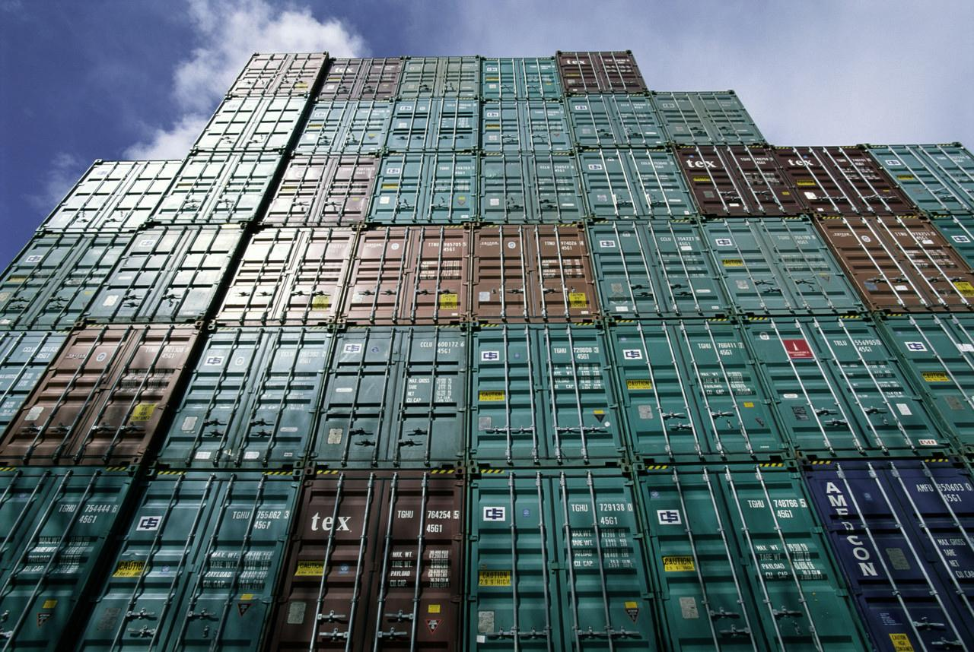


The Maldives and the
Generalized System of Preferences (GSP) Program
Edward Gresser
Assistant U.S. Trade Representative
Office of the United States Trade Representative
Executive Office of the President
June 2019

Slide 2
Presentation Summary
Overview of USTR and the U.S. GSP Program
GSP Exports and Benefits Review for the Maldives
How to increase use of duty-free opportunities

Slide 3
Role of USTR
(United States Trade Representative)
Cabinet-level agency which coordinates U.S. trade policy
  Acts as lead negotiator, administrator of preference programs, and represents U.S. at WTO
Led by Ambassador Robert Lighthizer
Office of Trade Policy and Economics administers GSP

Slide 4


GSP Program Overview
Enhanced access to U.S. market
  Provides duty-free treatment for almost 3,500 products from the Maldives
Expanded choices for U.S. industries and consumers
$23.5 billion in total U.S. GSP imports in 2018
GSP program currently
authorized through
December 2020

Slide 5
U.S. tariff schedule
Total of 11,083 products
4,084 MFN-zero products
  Includes fresh or chilled yellow fin tuna, fish fillets, live ornamental fish, radio navigational aids, and seat parts for vehicles
3,743 products are subject to permanent tariffs (and excluded from GSP)
  Includes most clothing, shoes, and automobiles
3,256 products are eligible for GSP benefits
  Includes measuring instruments and appliances, automatic regulating or controlling instruments, electric boards and panels, and tires

Slide 6
Country eligibility
Income under $12,055 per capita
Expropriation/Arbitral Awards
Taking steps to protect internationally recognized worker rights, including stopping child labor
Market Access for U.S. exports
U.S. Intellectual Property Rights protected
Full description and list in Guidebook
https://ustr.gov/sites/default/files/The%20GSP%20Guidebook.pdf

Slide 7


Which other countries are in GSP?
119 countries & territories including neighbors: Indonesia, Burma, Thailand, the Maldives, Cambodia, Madagascar, Mauritius, Cocos Islands, and Christmas Islands

Slide 8

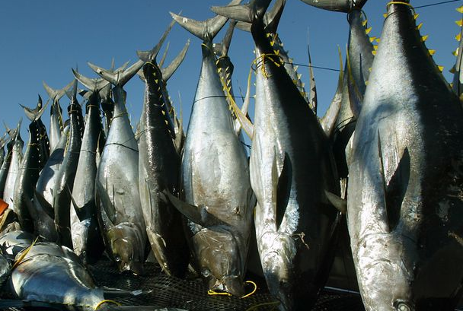

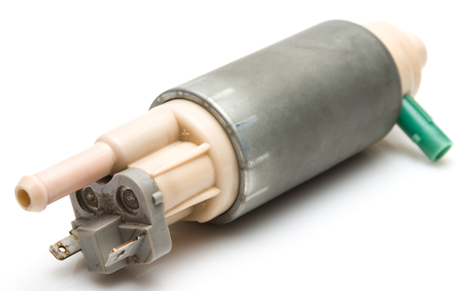

Product eligibility
Eligible
Ineligible
Many manufactured items and inputs
Travel goods (e.g. backpacks, purses)
Jewelry
Some agricultural products
Many chemicals
Many minerals
Most textiles and apparel
Watches
Footwear
Some gloves and leather goods
Many agricultural products

Slide 9
How to Qualify for Duty-Free Treatment under GSP
GSP-eligible product
Product or growth of the GSP Country
Local content must be ≥ 35% of the value
Can’t enter commerce of another country
Benefit claimed by importer
Keep records to verify GSP claim
9

Slide 10
Maldivian GSP exports to the
United States, 2018
Total exports were $26 million in 2018
In 2018, there were no exports under GSP
  About 75% of exports to the U.S. were MFN-duty free
Top GSP-eligible products, 2018:
  Measuring and checking instruments, appliances and machines ($49,000)
  Automatic regulating or controlling instruments and apparatus ($15,000)
  Boards, panels, etc., equipped with apparatus for electric control ($8,000)

Slide 11
Examples of potential duty savings on fish products, 2018
Description | HTS | MFN rate, or non-GSP rate | GSP rate | Example: $100 in imports
 |  |  |  | Imports from competitors | Imports from the Maldives | Duty savings
Coral, cut but not set, and cameos, suitable for use in jewelry | 9601.90.40 | 3% | 0% | $103 | $100 | $3
Tunas and skipjack, not in airtight containers, not in bulk or immediate containers >6.8 kg | 1604.20.60 | 15% | 0% | $115 | $100 | $15
Crab products containing fish meat | 1605.10.05 | 10% | 0% | $110 | $100 | $10

Slide 12
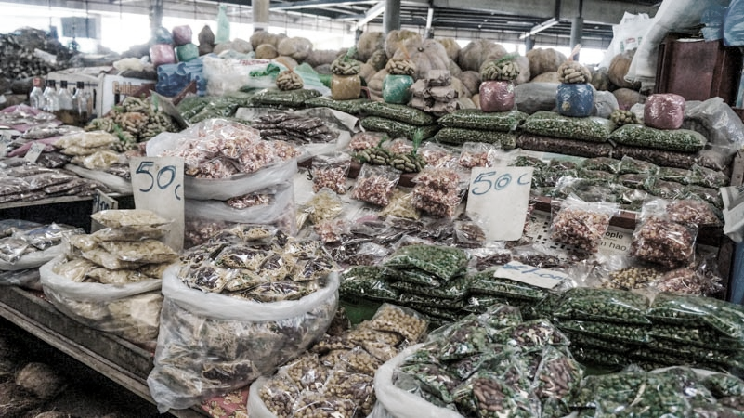
How to Increase Duty-Free Exports to the U.S.
Consider products with a GSP advantage
Identify GSP-eligible products exported to other markets
Ensure that GSP is claimed
Use GSP as a marketing tool

Slide 13
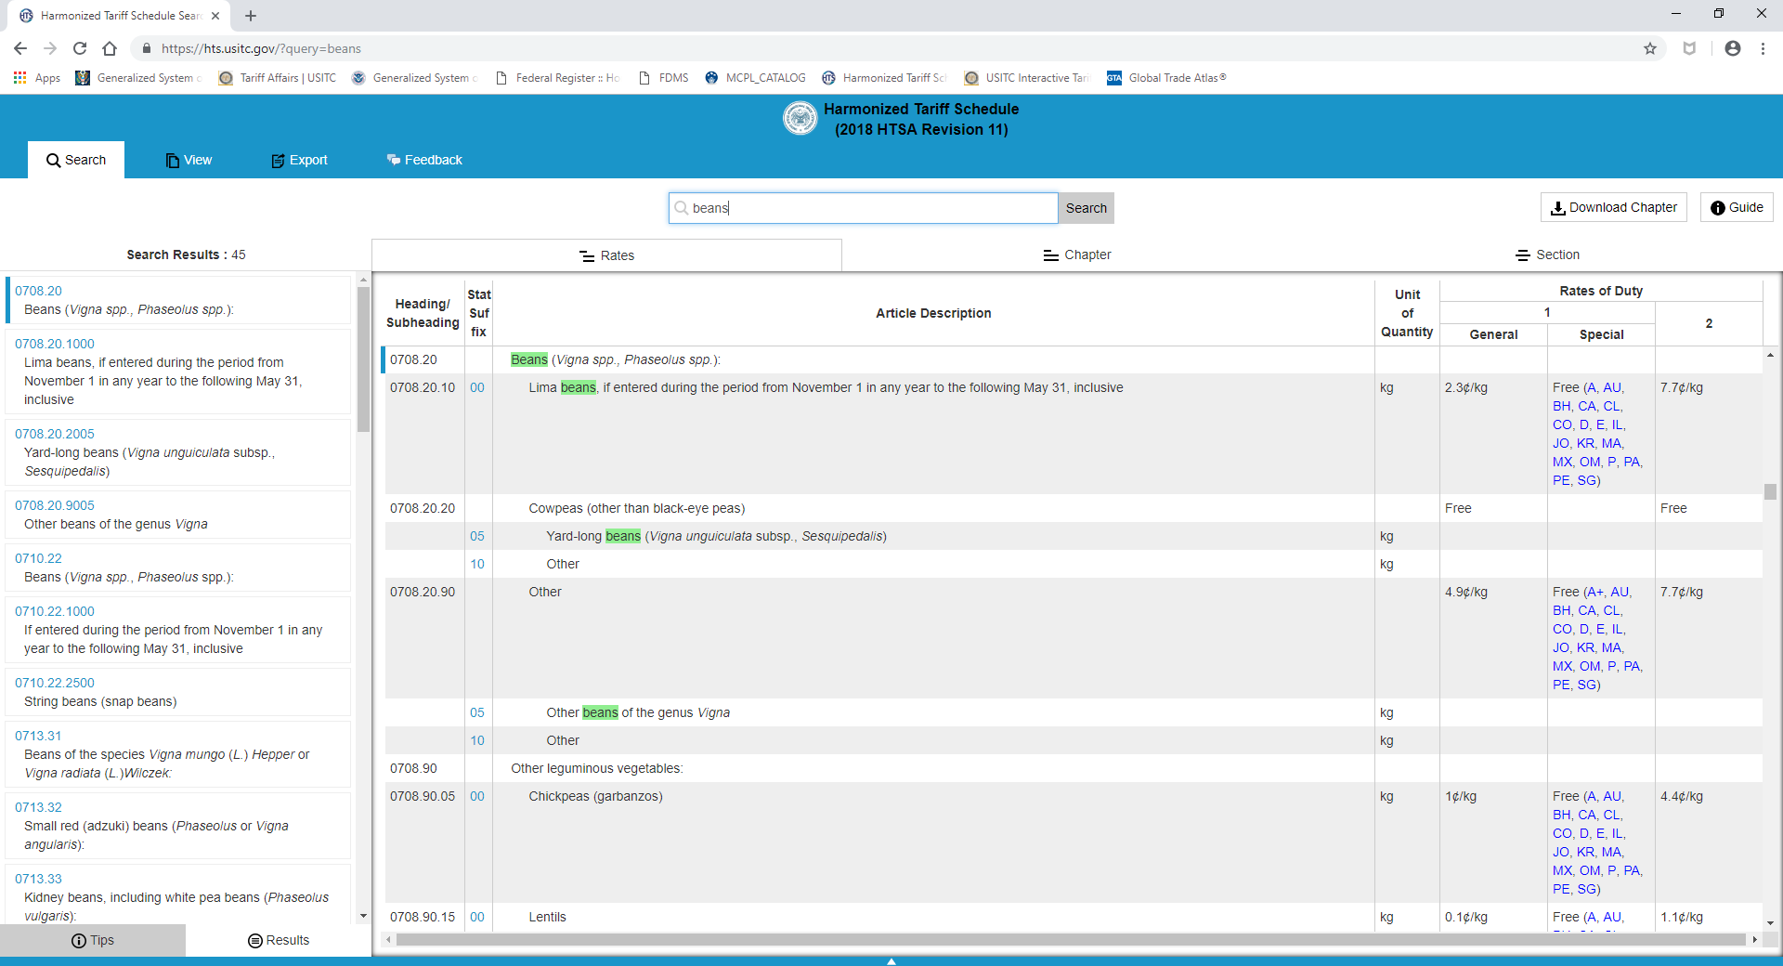
How to determine if a product is GSP eligible
Visit https://hts.usitc.gov
“A” = eligible for all BDCs
“A+” = eligible for LBDCs only

Slide 14
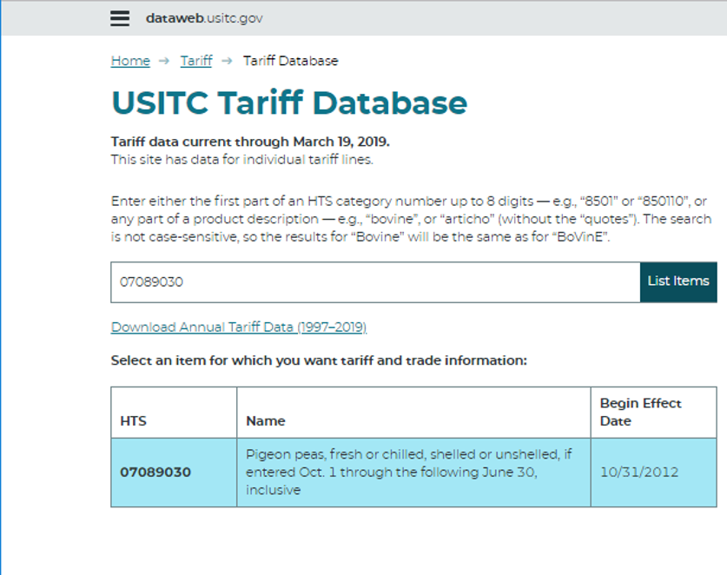
For more detailed product information
Visit https://dataweb.usitc.gov/tariff/database

Slide 15
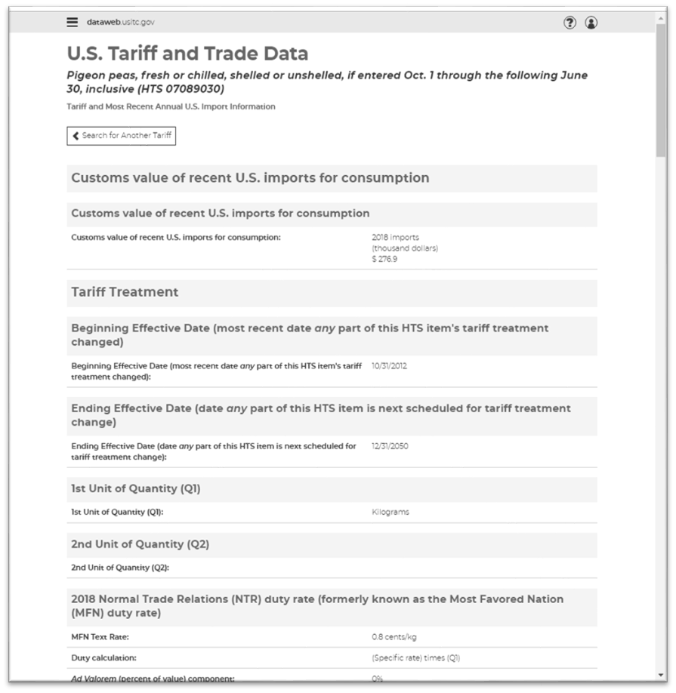
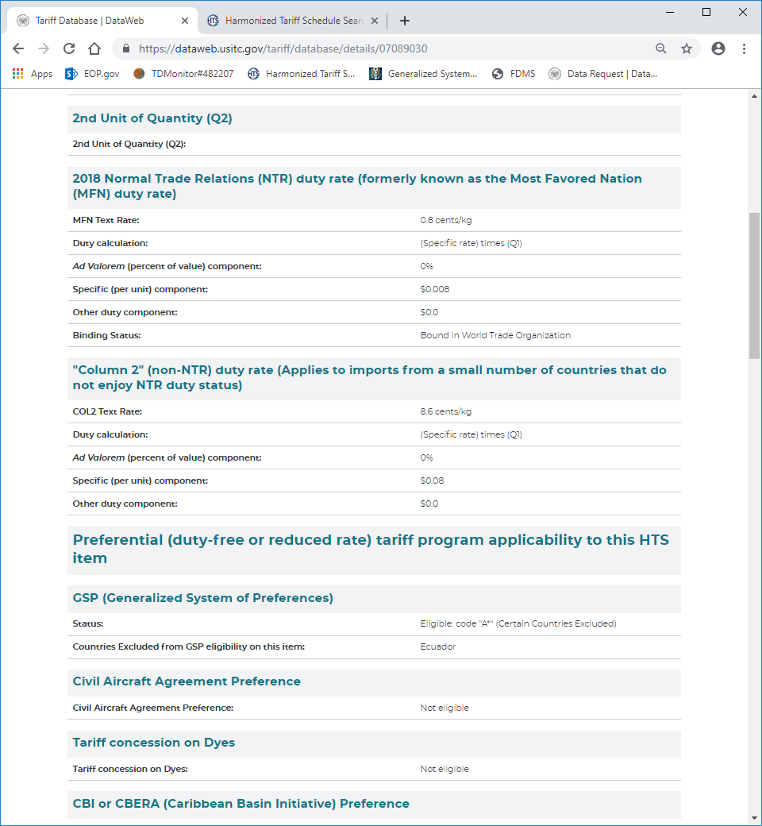
For more detailed product information
Visit https://dataweb.usitc.gov/tariff/database

Slide 16

GSP decision-making process to add or remove countries and products
Country-specific
Product-specific
Petitions submitted by interested parties
or
U.S. government self-initiates a review following the triennial country assessment process
Petitions submitted by interested parties
2018 examples:
  Redesignate ammonium perrhenate for Kazakhstan
  Removal of tart cherry juice for Turkey

Slide 17

Identifying & Developing Potential U.S. Buyers
Depends on size, sector, experience
Understanding the US market
What kind of relationship: agent, distributor, partner, joint venture
Best leads: your own network!
Trade shows

Slide 18
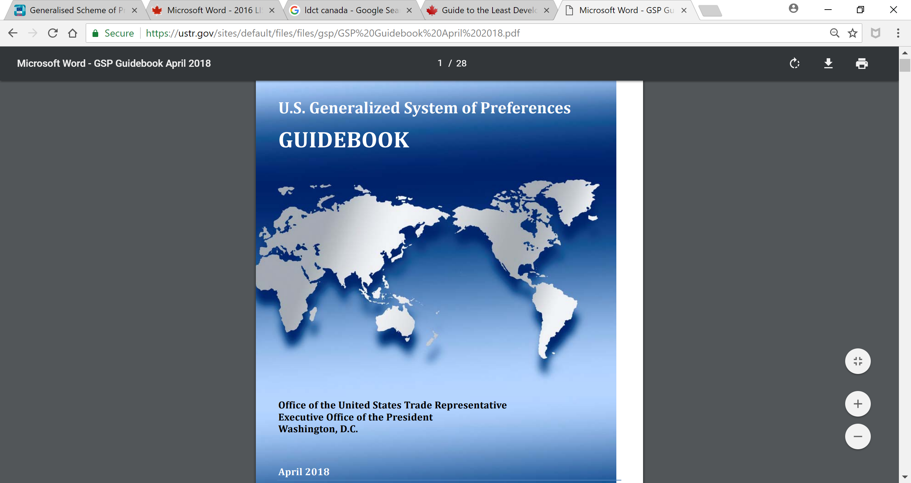
Questions on GSP?
USTR Contacts
Email: gsp@ustr.eop.gov
Phone: +1 (202) 395-2974
Website: https://ustr.gov/issue-areas/trade-development/preference-programs/generalized-system-preference-gsp

Slide 19
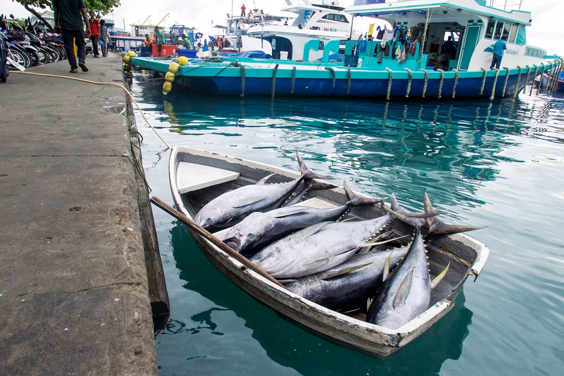
Thank you!

