Slide 1
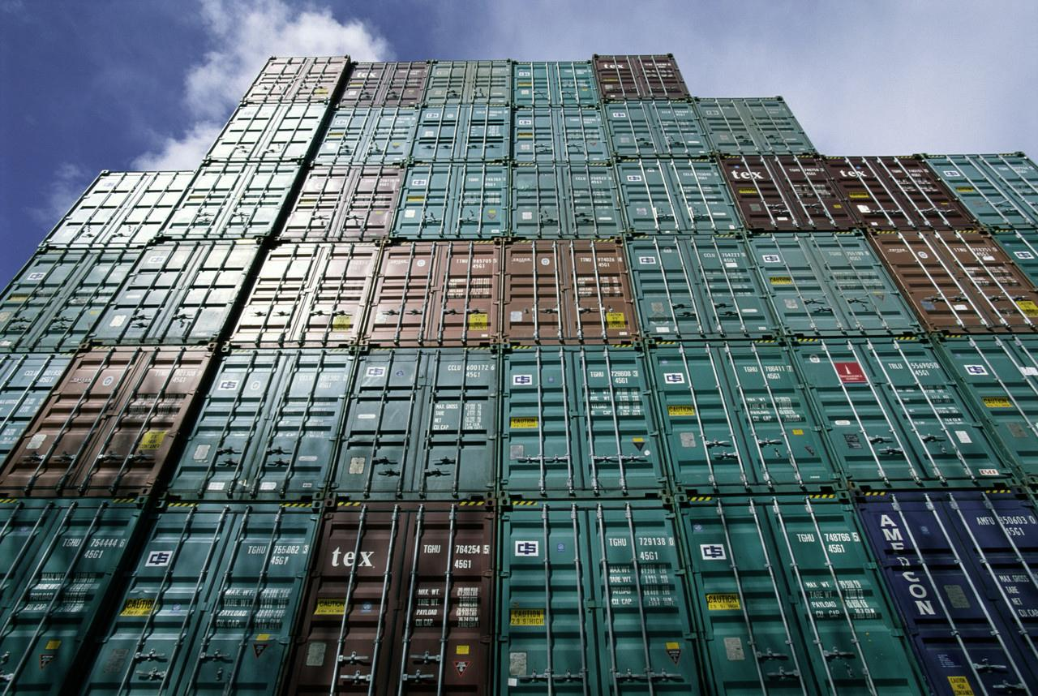


Sri Lanka and the
Generalized System of Preferences (GSP) Program
Edward Gresser
Assistant U.S. Trade Representative
Office of the United States Trade Representative
Executive Office of the President
June 2019

Slide 2
Presentation Summary
Overview of USTR and the U.S. GSP Program
GSP Exports and Benefits Review for Sri Lanka
How to increase use of duty-free opportunities

Slide 3
Role of USTR
(United States Trade Representative)
Cabinet-level agency which coordinates U.S. trade policy
  Acts as lead negotiator, administrator of preference programs, and represents U.S. at WTO
Led by Ambassador Robert Lighthizer
Office of Trade Policy and Economics administers GSP

Slide 4
Sri Lanka’s exports to the world, 2018
$11.6 billion in exports to the world
The United States is the single largest destination for Sri Lankan products
  $3.0 billion in exports to the U.S.
  $1.0 billion in exports to the U.K.
  $0.8 billion in exports to India
  $0.7 billion in exports to Germany

Slide 5


GSP Program Overview
Enhanced access to U.S. market
  Provides duty-free treatment for almost 3,500 products from Sri Lanka
Expanded choices for U.S. industries and consumers
$23.5 billion in total U.S. GSP imports in 2018
GSP program currently authorized
through December 2020

Slide 6
U.S. tariff schedule
Total of 11,083 products
4,084 MFN-zero products
  Includes solid or cushion rubber tires, rubies, sapphires, and emeralds, construction tires, some machinery parts, and fresh yellow fin tuna
3,743 products are subject to permanent tariffs (and excluded from GSP)
  Includes most clothing, shoes, and automobiles
3,256 products are eligible for GSP benefits
  Includes activated carbon, brooms, some nonalcoholic beverages, coconuts, precious metals, and green tea

Slide 7
Country eligibility
Income under $12,055 per capita
Expropriation/Arbitral Awards
Taking steps to protect internationally recognized worker rights, including stopping child labor
Market Access for U.S. exports
U.S. Intellectual Property Rights protected
Full description and list in Guidebook
https://ustr.gov/sites/default/files/The%20GSP%20Guidebook.pdf

Slide 8









Which other countries are in GSP?
119 countries & territories including neighbors: Indonesia, Burma, Thailand, the Maldives, Cambodia, Madagascar, Mauritius, Cocos Islands, and Christmas Islands

Slide 9

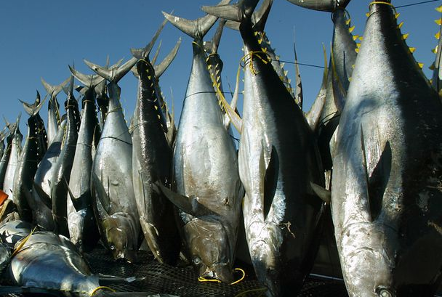

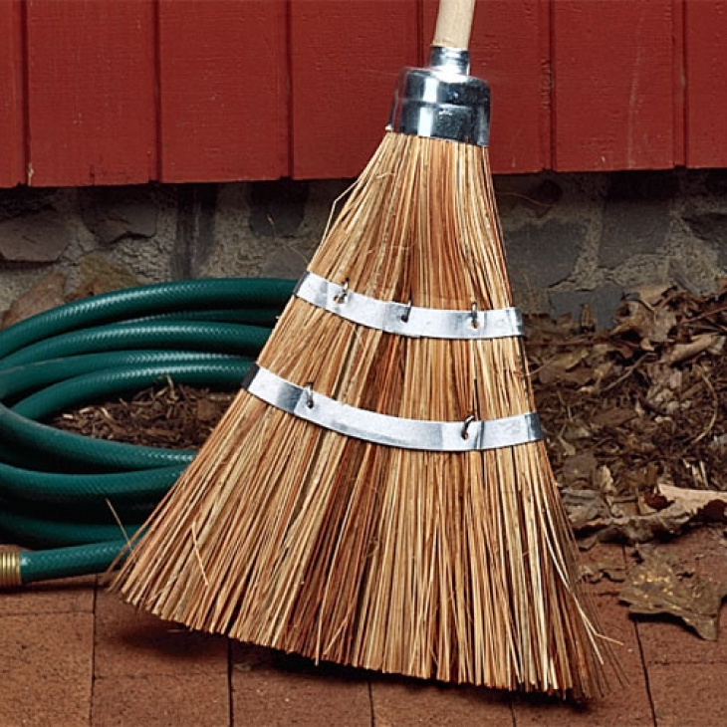

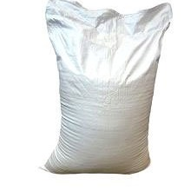
Product eligibility
Eligible
Ineligible
Many manufactured items and inputs
Travel goods (e.g. backpacks, purses)
Jewelry
Some agricultural products
Many chemicals
Many minerals
Most textiles and apparel
Watches
Footwear
Some gloves and leather goods
Many agricultural products

Slide 10
How to Qualify for Duty-Free Treatment under GSP
GSP-eligible product
Product or growth of the GSP Country
Local content must be ≥ 35% of the value
Can’t enter commerce of another country
Benefit claimed by importer
Keep records to verify GSP claim
10

Slide 11
Sri Lanka GSP exports to the
United States, 2018
Exports under GSP accounted for 6.4% of total exports to U.S.
  Total exports were $2.9 billion in 2018, $192 million of which were under GSP
  Exports under GSP decreased slightly by 1.8% from 2017-18
Top GSP products, 2018:
  Activated carbon ($28.1 million)
  New pneumatic tires for construction vehicles ($23.8 million)
  Seamless rubber gloves ($18.5 million)

Slide 12
Examples of duty savings on Sri Lankan exports, 2018
HTS8 description | MFN rate, or non-GSP rate | Imports for consumption (U.S. dollars) | Share of eligible imports using GSP (percent) | Duty savings (U.S. dollars) | Potential additional savings (U.S. dollars)
Activated carbon | 4.8% | $32,000,000 | 87% | $1,350,000 | $200,000
Fresh cherry juice | 0.5% | $2,700,000 | 100% | $14,000 | $0
Electric boards, panels, and consoles | 2.7% | $480,000 | 0% | $0 | $13,000
Travel, sports, and similar bags with a plastic outer surface | 20% | $31,000 | 20% | $1,000 | $5,000

Slide 13
Example: GSP advantage for Sri Lanka’s travel bags with plastic outer surface exports
HTS 4202.92.45
MFN (non-GSP) duty rate of 20.0%
Importers pay 20.0% duty when importing from many competitors, including China, Vietnam, and Italy
Importers pay 0% on GSP imports from Sri Lanka
Buyers would save $20.00 per $100 in travel bags from Sri Lanka

Slide 14
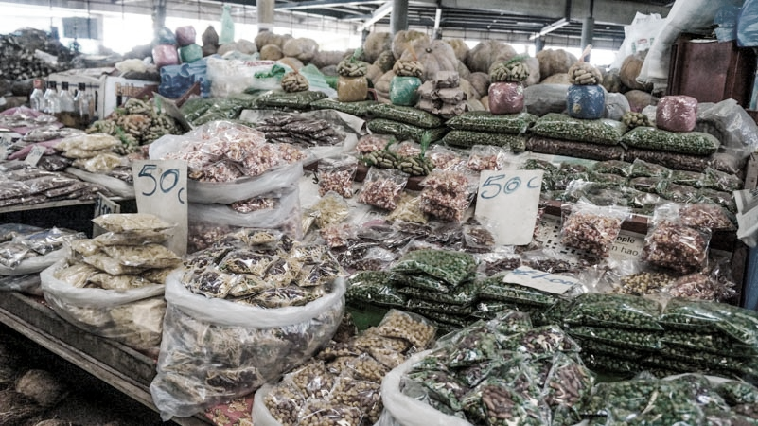
How to Increase Duty-Free Exports to the U.S.
Consider products with a GSP advantage
Identify GSP-eligible products exported to other markets
Ensure that GSP is claimed
Use GSP as a marketing tool

Slide 15
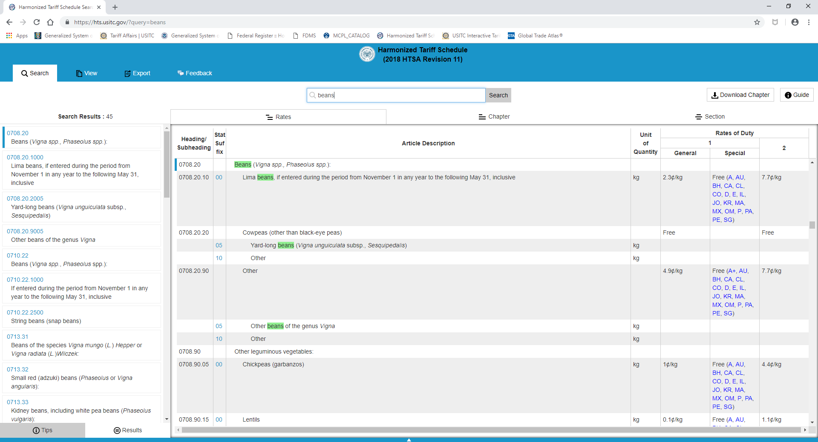
How to determine if a product is GSP eligible
Visit https://hts.usitc.gov
“A” = eligible for all BDCs
“A+” = eligible for LBDCs only

Slide 16
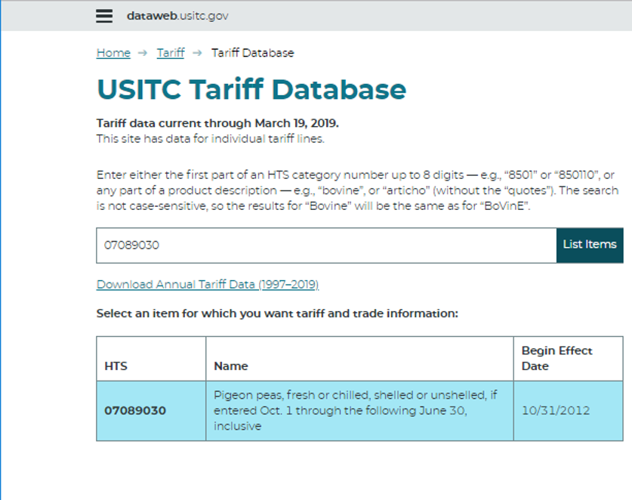
For more detailed product information
Visit https://dataweb.usitc.gov/tariff/database

Slide 17
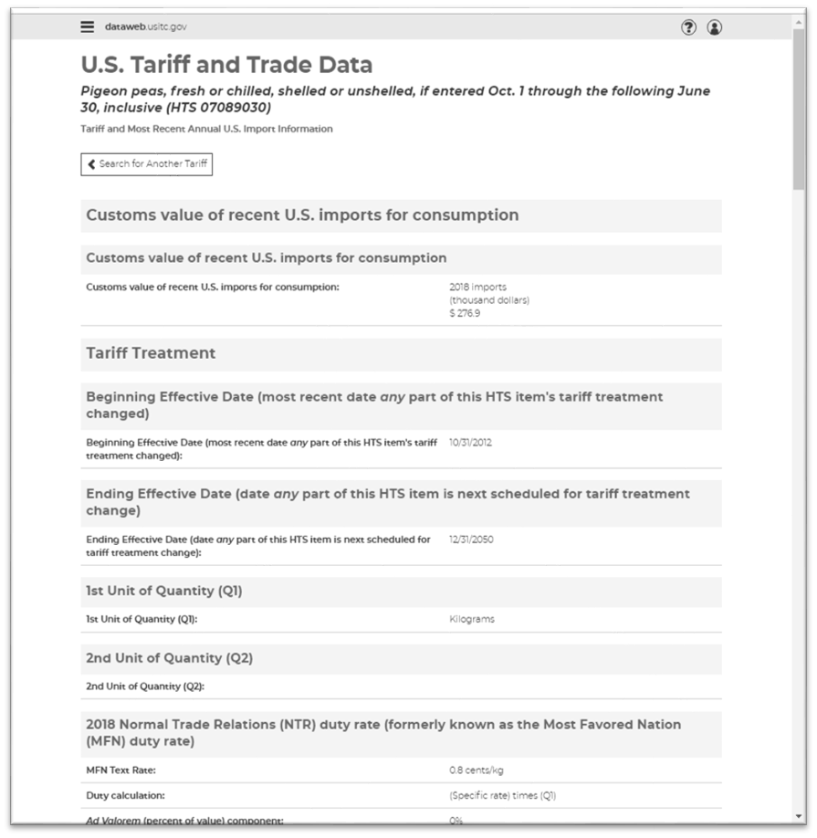
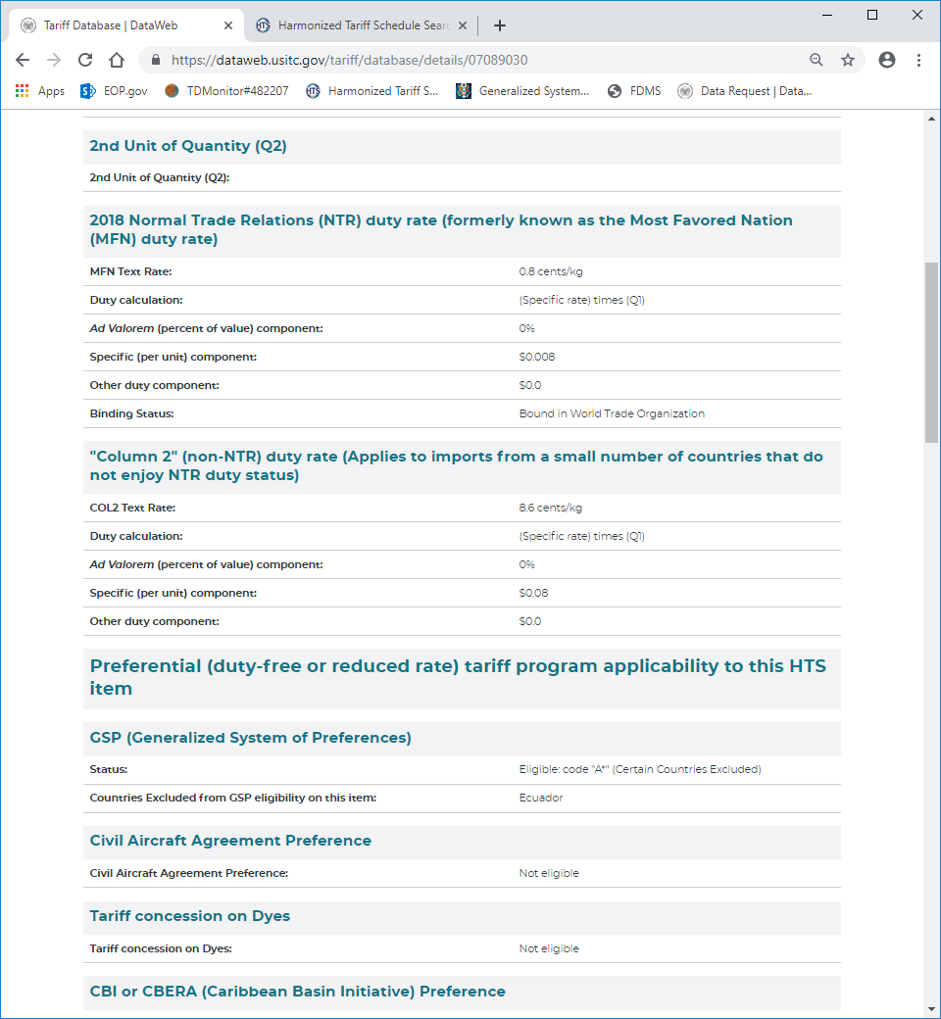
For more detailed product information
Visit https://dataweb.usitc.gov/tariff/database

Slide 18

GSP decision-making process to add or remove countries and products
Country-specific
Product-specific
Petitions submitted by interested parties
or
U.S. government self-initiates a review following the triennial country assessment process
Petitions submitted by interested parties
2018 examples:
  Redesignate ammonium perrhenate for Kazakhstan
  Removal of tart cherry juice for Turkey

Slide 19

Identifying & Developing Potential U.S. Buyers
Depends on size, sector, experience
Understanding the US market
What kind of relationship: agent, distributor, partner, joint venture
Best leads: your own network!
Trade shows

Slide 20
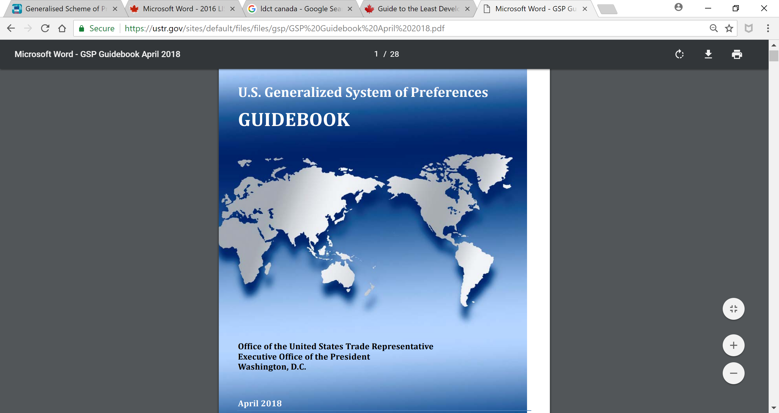
Questions on GSP?
USTR Contacts
Email: gsp@ustr.eop.gov
Phone: +1 (202) 395-2974
Website: https://ustr.gov/issue-areas/trade-development/preference-programs/generalized-system-preference-gsp

Slide 21
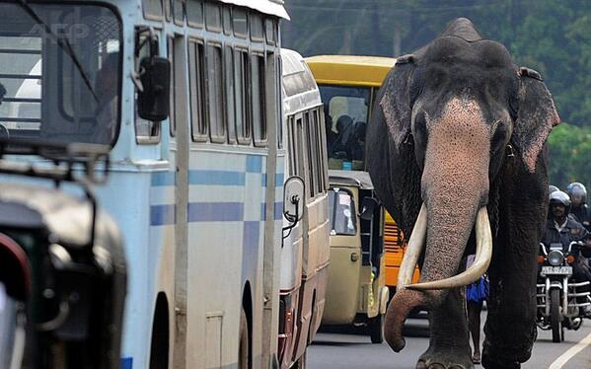
Thank you!

