Slide 1
GSP & Central Asia
Erland Herfindahl
Deputy Assistant U.S. Trade Representative
Office of the united states trade representative
Executive office of the president
December 2017

Slide 2




Central Asia
GSP Eligible Countries
Afghanistan
Kazakhstan
Uzbekistan
Kyrgyzstan

Slide 3
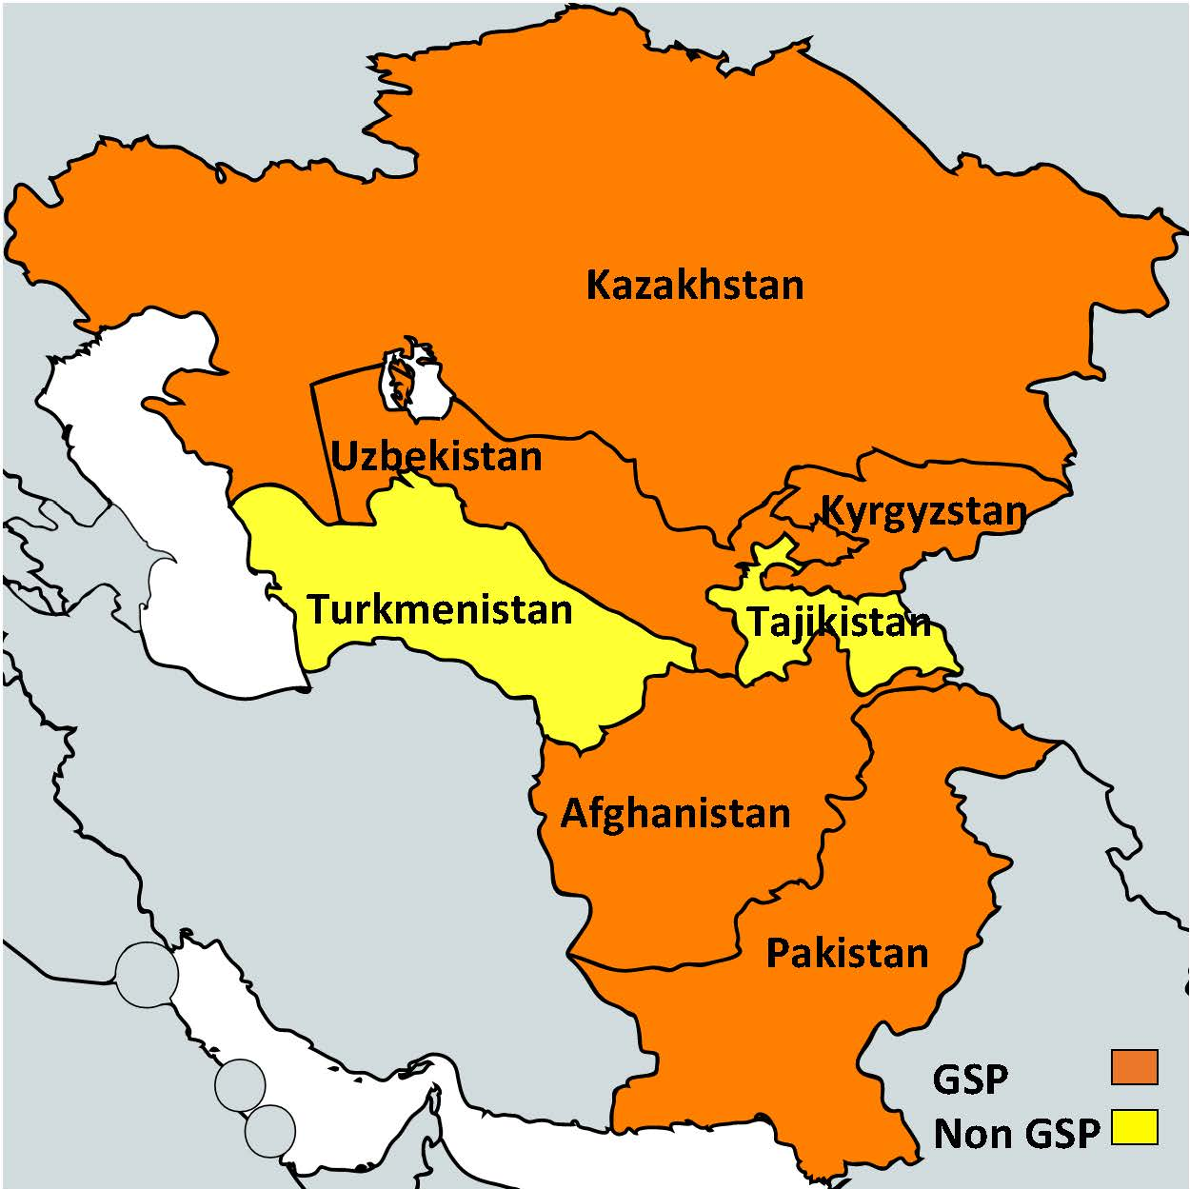

Slide 4
Presentation Summary
Overview of the U.S. GSP Program
Central Asian GSP exports to the U.S.
How to increase Central Asian use of duty-free opportunities

Slide 5
The United States is the biggest single trading nation in the world
$2.2 trillion in exports
$2.7 trillion in imports

Slide 6


GSP Program
Enhanced access to U.S. market
Expanded choices for U.S. industries & consumers
Provides duty-free treatment for almost 3,500 products from Central Asia (Additional 1,400 products from Least Developed countries including Afghanistan)
$18.9 billion in total U.S. GSP imports (2016)
GSP program authorized through December 2017

Slide 7

New Administration Trade Policy:
EXPAND OUR GOODS AND SERVICES EXPORTS
ENFORCE U.S. TRADE LAWS
PROTECT U.S. INTELLECTUAL PROPERTY RIGHTS

Slide 8
Country Eligibility Criteria
Income under $12,400 per capita
Expropriation/Arbitral Awards
Worker rights, including stopping child labor
Market Access for US exports
US Intellectual Property Rights protected
Full description and list in Guidebook

Slide 9
Benefits of GSP
Diversify exports
Improved employment opportunities
Economic development

Slide 10




How many HTS lines are eligible for GSP duty-free treatment?
Dutiable lines:
1,941
17%
MFN duty-free
lines, 4,084
37%
GSP-eligible lines
(LDCs), 1,519
14%
GSP-eligible lines
GSP-eligible lines (all BDCs), 3,537
32%

Slide 11
U.S. and Central Asia Trade in 2016
Afghanistan
  Total U.S. imports: $34 million
  GSP imports: $324 thousand
Kazakhstan
  Total U.S. imports: $632 Million
  GSP imports: $ 89 Million
Kyrgystan
  Total U.S. imports: $ 3 Million
  GSP imports: $ 24 thousand
Uzbekistan
  Total U.S. imports: $30 Million
  GSP imports: $3.1 Million
11

Slide 12
Kazakhstan Top GSP Exports
in 2016
HTS Chapter & Product Description | GSP Tariff Advantage | Total GSP Value
Lead | 2.5% | $19,867,985
Tantalum | 2.5% | $19,117,480
Ferrochromium | 3.1% | $16,232,538
Silicon | 5.3% | $15,224,656

Slide 13




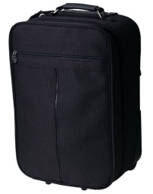


GSP Program: Eligible Products
Eligible
Many manufactured items & inputs
Jewelry
Many agricultural products
Chemicals
Minerals
Travel Goods
Carpets
Ineligible
Most textiles & apparel
Watches
Footwear
Some gloves & leather goods

Slide 14


New GSP products:
“Travel goods”
U.S. Market for “Travel Goods” including Luggage, Purses, Backpacks, and “Pocket Goods” such as wallets, eyeglass cases: $10 Billion
Duties range from 6 to 20% depending on product

Slide 15
How to Qualify for Duty-Free Treatment under GSP
GSP-eligible product
Product or growth of the GSP Country
Local content g must be ≥ 35% of the value
Can’t enter commerce of another country
Benefit claimed by importer
Keep records to verify GSP claim
15

Slide 16
Is my product eligible for duty-free treatment under GSP?
Dataweb:
List of GSP-eligible products at:
https://dataweb.usitc.gov/scripts/tariff_current.asp
https://ustr.gov/issue-areas/trade-development/preference-programs/generalized-system-preferences-gsp/gsp-program-i-0

Slide 17

How to Increase Duty-Free Imports into the U.S.
Use GSP as a marketing tool
Ensure that GSP is claimed
Identify GSP-eligible products exported to other markets
Consider products with a GSP advantage
17
Notes:
Fix bullets

Slide 18

Identifying & Developing Potential U.S. Buyers
Depends on size, sector, experience
Understanding the US market
What kind of relationship: agent, distributor, partner, joint venture
Best leads: your own network!
Trade shows

Slide 19
Annual GSP Review Process
Add products to GSP for ALL countries or Least Developed Countries (if not excluded by law)
Remove products: Competitive Need Limitations; or U.S. industry petition
Remove or add countries’ GSP benefits

Slide 20
Petition Process to Add New Products
Product must not be excluded by statute (e.g., apparel)
Submit petition during Annual Review
Provide the required information

Slide 21
For Further Information
GSP General Information:
U.S. Department of Homeland Security: Customs and Border Protection (CBP):
https://ustr.gov/issue-areas/trade-development/preference-programs/generalized-system-preference-gsp
http://www.cbp.gov
21

Slide 22
For Further Information
U.S. Tariff Databases:
http://www.usitc.gov/tariff_affairs/tariff_databases.htm
See esp. General Note 4.
http://usitc.gov/tata/hts/bychapter/index.htm
U.S. Tariff Schedule:
22

Slide 23
For Further Information
U.S. Food and Drug Administration:
Questions on GSP?
http://www.fda.gov/ForIndustry/FDABasicsforIndustry/default.htm
USTR contact: gsp@ustr.eop.gov or + 1-202-395-2974

Slide 24

Thank you!

